Slide 1
Our Rotary Foundation
Why should I donate to The Rotary Foundation?
Giving works because Rotary works. We are proud that 90.8 percent of donations go straight to supporting our service projects.
Why should I donate to The Rotary Foundation?
Giving works because Rotary works. We are proud that 90.8 percent of donations go
How does The Rotary Foundation use donations?
Our 35,000 clubs carry out sustainable humanitarian service projects. Using donations like yours, we’ve wiped out 99 percent of all polio cases. Your donations train future peacemakers, support clean water, and strengthen local economies.
What impact can one donation have on the world?
It can save a life. A child can be protected from polio with as little as 60 cents. Our partners make your donation go even farther. For every $1 Rotary commits to polio eradication, the Bill & Melinda Gates Foundation has committed $2.

Slide 2
Rotary Foundation
Polio Plus
  Rotary, along with our partners has reduced polio cases by 99.9 percent worldwide since our first project to vaccinate children in the Philippines in 1979
  Rotarians have helped immunize more than 2.5 billion children against polio in 122 countries. For as little as $0.60, a child can be protected against this crippling disease for life.
  The Gates Foundation and Rotary International have an ongoing match of 2:1 to support polio eradication efforts up to $35 million a year.
  Raise awareness & funds in your community to eliminate Polio from the world
  District 5630 contributes 20% of DDF to Polio Plus
  “Rotary Clubs set an annual goal for supporting Polio Plus in Rotary.org”

Slide 3
Rotary Foundation
ENDOWMENT INVESTMENTS INVESTMENT OBJECTIVE
  The Rotary Foundation invests Endowment assets to ensure funding for today’s programs while sufficiently growing the portfolio to support Foundation programs in the future.
  Each year, The Rotary Foundation awards up to 100 fully-funded fellowships for upcoming social change leaders who want to study peace and development at one of our peace centers. Right now, we have 98 fellows studying in the U.S., Japan, the U.K., Australia, Sweden, and Thailand.
  Contributions to Rotary’s Endowment are invested and professionally managed to provide a stream of income to support Rotarians’ local and global philanthropic work in perpetuity.
  Endowment Fund contributions = Benefactor, Bequest, Major Donor, Arch Klumph
  Only investment earnings are spent

Slide 4
Annual Fund
Funds District & Global Humanitarian Grants
  Rotary Foundation Sustaining Member
    When you give $100 or more per year to the Annual Fund.
  Paul Harris Fellow
    When you give $1,000 or more to the Annual Fund, PolioPlus, or an approved Foundation grant.
  Paul Harris Society member
    When you elect to contribute $1,000 or more annually to the Annual Fund, PolioPlus, or an approved Foundation grant.

Slide 5
Annual Fund
Funds District & Global Humanitarian Grants
100% Foundation Giving Club
  For clubs that achieve an average of $100 in per capita giving and 100 percent participation, with every dues-paying member contributing at least $25 to any or all of the following during the Rotary year: Annual Fund, PolioPlus Fund, approved global grants, or Endowment Fund.
Every Rotarian, Every Year Club
  For clubs that achieve a minimum Annual Fund contribution of $100 per capita during the Rotary year, and every dues-paying member must personally contribute at least $25 to the Annual Fund during the year.
  “Rotary Clubs set an annual goal for supporting Annual Fund in Rotary.org”

Slide 6
Contributing to the Rotary Foundation
How to Contribute
Endowment Fund
  Permanent Fund-SHARE
  Permanent Fund-World Fund
  Rotary Peace Centers Endowment
PolioPlus Fund
  End Polio Now. Be a part of history and help Rotary achieve a polio-free world. Eligible for Paul Harris Fellow recognition.
Approved Global Grants
  Support an approved global grant. An assigned 7-digit grant number is required.
  Grant Number: (Eligible for Paul Harris Recognition – But not Share)

Slide 7

RECURRING GIVING: ROTARY DIRECT
    Safe, secure, and easy
    Give monthly, quarterly, or annually
    Enroll at www.rotary.org/give
Notes:
One of the easiest and most secure ways for us to support our Foundation is through Rotary’s recurring giving program, Rotary Direct. Select an amount, frequency (monthly, quarterly or annually), and contribution method that is convenient for you.
Enrollment is integrated with the Foundation’s secure online contribution system and is available in multiple currencies.
Efficient, convenient and secure.
The Rotary Foundation will send you one annual statement of Rotary Direct contributions for tax purposes (where applicable).

Slide 8
District Foundation
Annual Fund Challenge
(First 100) - Rotarians signing up for Rotary Direct from (3/1/19 – 6/30/19) to the Annual Fund Share the District will credit $50 dollars to their Annual Fund Share Account.

Slide 9
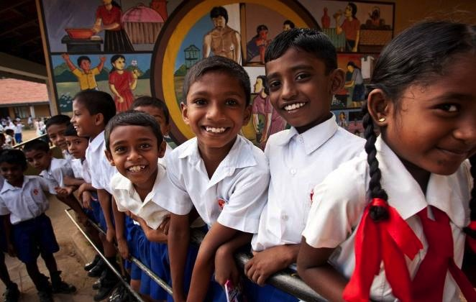
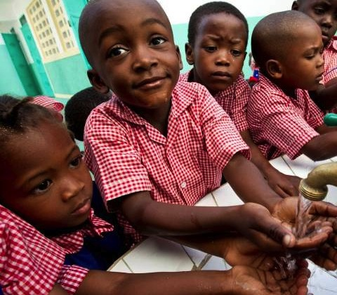
HOW WE FUND PROGRAMS – SHARE SYSTEM
50%
District Designated Fund (DDF)
50%
World Fund
Notes:
To review: when we contribution to Annual Fund – SHARE, fifty percent (50%) of our contributions come back to our district through District Designated Funds (DDF) in three years to spend on educational and humanitarian activities chosen by us; even grants that may be used for projects in our local community.
The 5 percent that is earmarked to potentially pay for the Foundation’s operating expenses will come from the World Fund. It will be used only if it is needed to pay expenses when net investment returns are not sufficient, or to fully fund the operating reserve (up to three times annual operating expenses). If funds are not needed for these purposes, they will remain in the World Fund until the World Fund is measured to ensure sufficient funds for programs.
In the final step, the World Fund will be measured to ensure that it contains 50 percent of the three prior years’ worth of contributions, plus $5 million – a growth factor. Then and only then, surplus funds will be transferred to the Endowment Fund.
This funding model:
Builds our financial strength by ensuring that resources are available to meet current needs: programs and operating expenses.
Establishes a reserve to provide for unusual financial events (a rainy day fund): the operating reserve.
Ensures an increase in future programs through increased returns on the Endowment Fund.

Slide 10
HOW WE FUND PROGRAMS – SHARE SYSTEM
50%
District Designated Fund (DDF)
25%
District Grants to Clubs
25%
Global Grants
50%
World Fund Rotary Foundation
Global Grants Match
DDF $1 per $1
Club Cash $.50 per $1
Notes:
To review: when we contribution to Annual Fund – SHARE, fifty percent (50%) of our contributions come back to our district through District Designated Funds (DDF) in three years to spend on educational and humanitarian activities chosen by us; even grants that may be used for projects in our local community.
The 5 percent that is earmarked to potentially pay for the Foundation’s operating expenses will come from the World Fund. It will be used only if it is needed to pay expenses when net investment returns are not sufficient, or to fully fund the operating reserve (up to three times annual operating expenses). If funds are not needed for these purposes, they will remain in the World Fund until the World Fund is measured to ensure sufficient funds for programs.
In the final step, the World Fund will be measured to ensure that it contains 50 percent of the three prior years’ worth of contributions, plus $5 million – a growth factor. Then and only then, surplus funds will be transferred to the Endowment Fund.
This funding model:
Builds our financial strength by ensuring that resources are available to meet current needs: programs and operating expenses.
Establishes a reserve to provide for unusual financial events (a rainy day fund): the operating reserve.
Ensures an increase in future programs through increased returns on the Endowment Fund.

Slide 11
Qualifying Your Club
District Grants 2019 - 2020
Grant Qualifications and Applications
District Qualification
  Annual MOU (Memorandum of Understanding)
  DG, DGE, & DRFC authorize online annually
Club Qualification
  Annual MOU (the Club’s President and President-elect must sign)
  At least one member complete grant management training
  Club be current on IRS 990 filing
  Club must be current on District & RI Dues
  Club will have a current Annual Fund Foundation goal set in rotary.org (by 12/31/18)

Slide 12
WWW.matchinggrants.org
All District 5630 “District Grants” will be submitted and administrated on this website. All Clubs can create a project page, enter the description, contact information, financing (including requested DDF), photos, supporting documents, etc. Once the project is ready, it can be digitally signed by the Primary contact person and club president. On signing a project, the user specifies they agree to the Terms and Conditions for District Grants specified by Rotary International & Rotary District 5630.
https://my.rotary.org/en/document/terms-and-conditions-rotary-foundation-district-grants-and-global-grants

Slide 13
District Grant Training
At least one member of a Club is required to complete grant training annually
Club member attending training must have a rotary.org account
Grant Training is required for Clubs to sponsor both District & Global Grants
Multiple training sessions will be offered in March – April 2019, via Zoom
All training will be offered by Zoom tele-conference (1.5 hour sessions)
Grant Training information will be available on www.Rotary5630.org

Slide 14
District Grant Application
District Grant Application 2019-2020 Rotary Year
  Due Online May 15th, 2019
  Application on www.matchinggrants.org will include:
    Club MOU executed (uploaded) on documents tab
    Current 990 IRS (uploaded) on documents tab
    Project budget must be fully pledged
    Qualified Clubs can submit multiple grants to use their DDF allocation
    Club cash – 25% of DDF allocation per grant
    Any unrequested DDF will be disbursed at the District’s discretion

Slide 15
District Grant Application
www.matchinggrants.org
  District Grants
  “Submit Project” (located on main header)
  Select 2019-2020 Rotary Year
  Enter Project description, contact information, and budget
  To upload reports, documents, & photo’s – click on Administration tab
  All District Grant information will be entered & tracked on this site
  Each Club will have a determined $ allocation of DDF each year
  Club $ allocation = 25% of Club’s Annual Fund contribution from 2016-2017 (min $500)
  Clubs required to contribute 25% of DDF allocation as cash to the project
  Grant can support a local or global humanitarian project
  Rotarian engagement and participation required

Slide 16


Create Your Project Site

Slide 17
Creating Your Club’s Project
Description Tab

Slide 18
Enter Your Project Financials
Financing Tab

Slide 19
Upload Your Project Documents
Documents Tab

Slide 20
Upload Project Photos
Photos Tab

Slide 21
Project History Log
History Logs Tab

Slide 22
Final Report Document
Administration Tab

Slide 23
Global Grant Application
www.rotary.org
  Global Grants
  All Global Grants are entered and administered online @ rotary.org
  Global Grant applications are on first come basis
  Requires a qualified District & Club in both the Host and International countries
  District Designated Funds are matched $1 per $1 from the World Fund
  Club Cash Funds are matched $.50 per $1 from the World Fund
  Projects need to be measurable, sustainable, & from the Six Areas of Focus
  Grant can support a local or global humanitarian project, & Vocational Training Teams
  Rotarian engagement and participation required

Slide 24
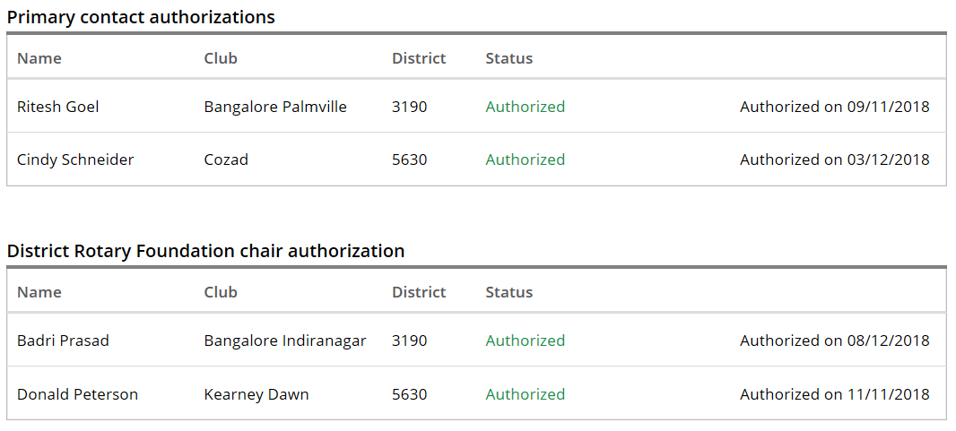
Authorizations & Legal Agreements

Slide 25
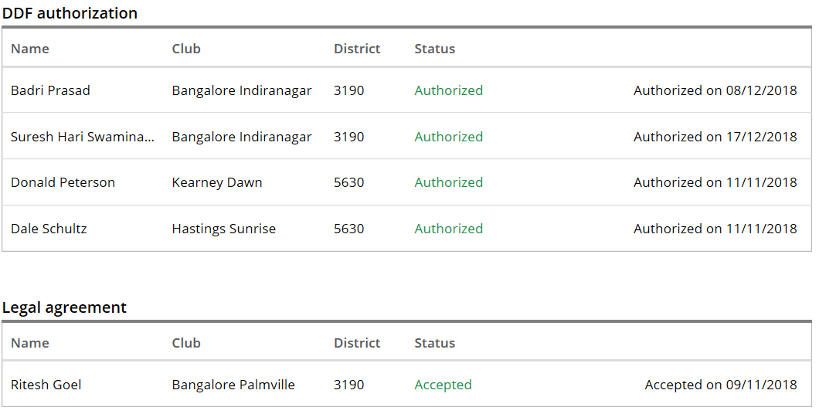
Authorizations & Legal Agreements

Slide 26
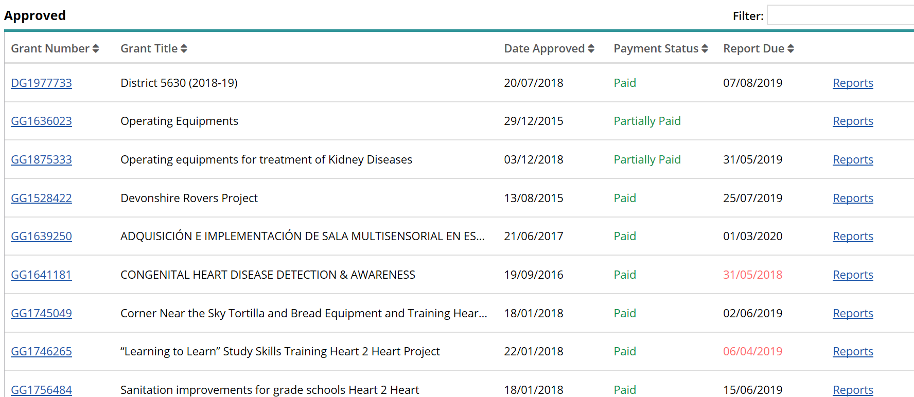
Global Grant Reporting

Slide 27
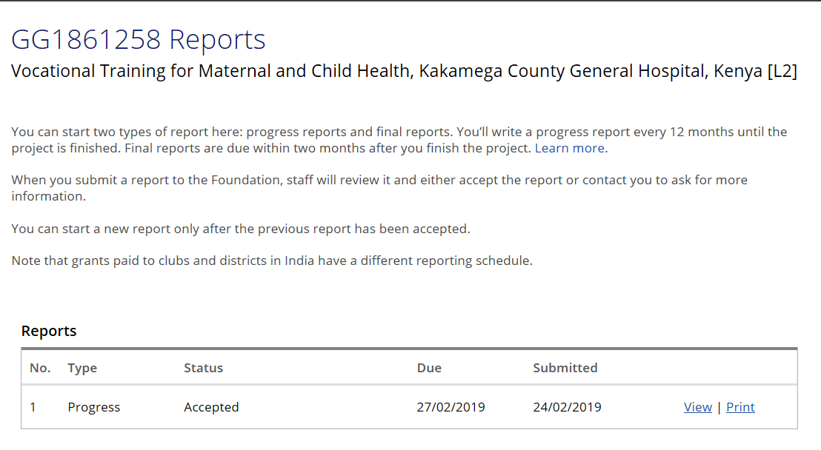
Global Grant Report

